Slide 1
Plant Pathology Lab – Week 2
Welcome!

Slide 2
QUIZ TIME!!

Slide 3
Meet the TAs!
Shankar K. Shakya (Advisor : Nik Grunwald, USDA)
shakyash@oregonstate.edu
Office Hours: Friday 1-3 PM
Office: Cordley 3077
Alex Wong
wonga4@oregonstate.edu (Advisor : Walt Mahaffee, USDA)
Office Hours: Thursday 2-4 PM and by appointment
Office: Cordley 3077

Slide 4
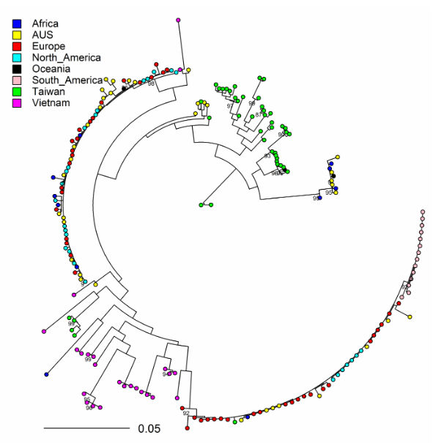
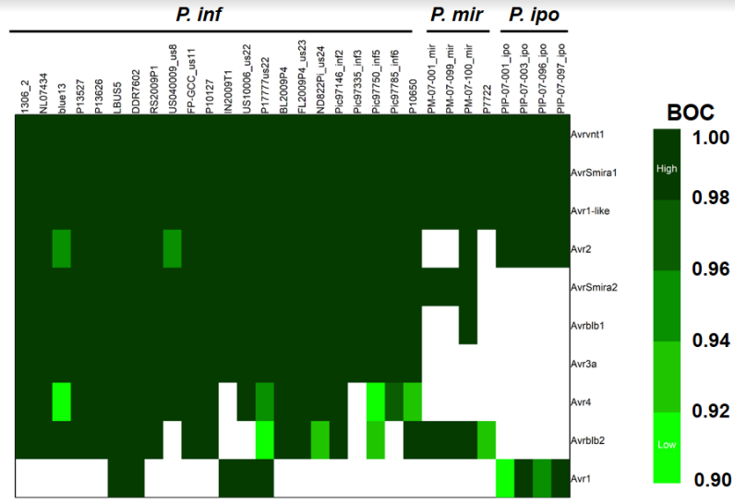
Shankar K. Shakya
M.S Plant Pathology, 2014 (University of Florida)
B.S Plant Pathology , 2011 (Nepal)
Epidemiology, population genetics and genomics of Phytophthora species

Slide 5
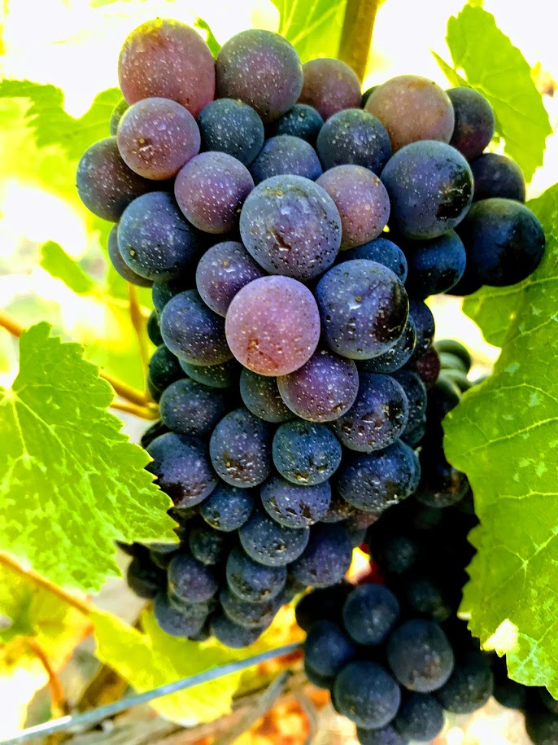

Alex Wong
M.S Plant Pathology, 2018 (Virginia Tech)
B.S Molecular Cell/Developmental Biology, 2016 (University of Pittsburgh)
Fungicide resistance of E. necator powdery mildew of grape
Notes:
Applied pathogenicity trials
Genetic identification
Phylogenetic analyses

Slide 6
Laboratory Expectations
What you can expect from your TAs:
Laboratory prepared with clear instructions
PowerPoint with necessary information and review
Clear due dates
10 point quiz promptly at beginning of lab
Return grades promptly
Create an enjoyable plant pathology laboratory experience

Slide 7
Laboratory Expectations
What we expect from you:
Show up on time – Quizzes will be the first 10 minutes of class
Have read required lab manual pages BEFORE class
Ask questions
Be responsible students
Follow the University Code of Student Conduct
Create an enjoyable plant pathology laboratory experience

Slide 8
IMPORTANT QUIZ INFORMATION
First quiz missed is a zero.
Second quiz missed will be made up on your own time.
Quiz questions cover the introductory lab material for the current week and one or two questions from the previous lab material.
Make sure you read the introduction from your lab manual before coming to class
DOING A GOOD JOB ON YOUR LAB NOTEBOOK IS KEY TO GETTING A GOOD GRADE ON THE QUIZZES AND IN THIS CLASS
Notes:
Class info/ lab info is all FAIR game for quizzes

Slide 9
Field Trip Review
Primary Symptom: Symptom induced by a plant pathogen where you are able to locate the pathogen itself
(Necrosis, leaf spot)
Secondary Symptom: Symptom caused by damage from the pathogen yet distal from the site of infection
(wilt, chlorosis, defoliation)
Sign: Direct evidence of the pathogen itself
(fruiting bodies, mycelium, bacterial ooze)

Slide 10
Plant Pathology Lab – Week 2
Isolation of Fungal Pathogens
pp. 7-11 (Baiting)
Oomycota
p.27-34

Slide 11
Major Differences Between Oomycota and True Fungi
Oomycota
Produce coenocytic mycelium
Cell walls made of cellulose
Heterokont flagella
Vegetative state is diploid
True Fungi
Many have septate mycelium
Cell walls made of chitin
Lack heterokont flagella
Vegetative state usually haploid

Slide 12
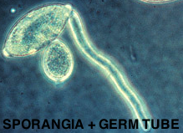
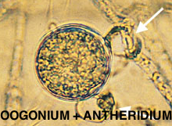
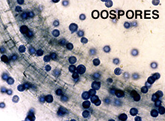
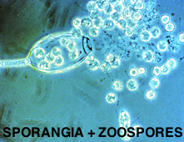
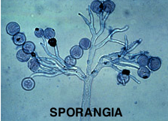
Oomycota Reproduction
Notes:
Asexual
Sporangia
Will germinate and form:
Zoospores (in cooler temp)
Germ tube (in warmer temp
Sexual
Gametes
Oogonium (contains egg)
Antheridium
Fertilization results in thick-walled oospore
Oospore= resting spore, can germinate to form:
Zoospore
Germ tube

Slide 13
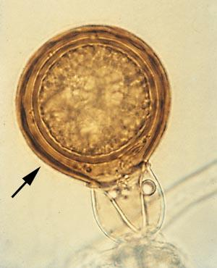
Sexual Reproductive Structures
Antheridium
Collar
After fertilization, Oogonium matures into an oospore.

Slide 14
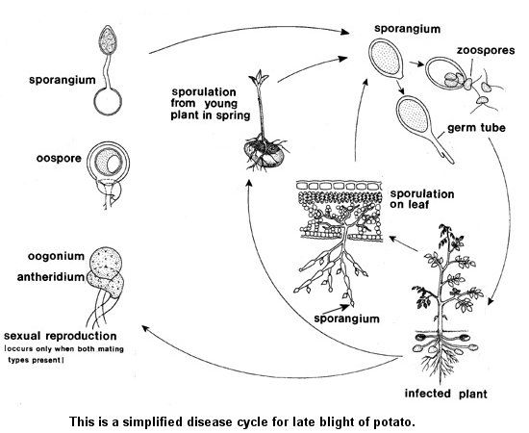
Late Blight of Potato Disease Cycle
Asexual Repeating Cycle (Summer)
Overwintering
Asexual Cycle
Sexual Cycle

Slide 15
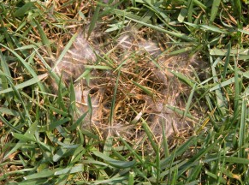
Plant Pathogenic Oomycetes
Pythiaceae – non-obligate parasites or saprobes
Phytophthora spp. - root rots, late blight
Pythium – damping off, seed decay, fruit rots
Notes:
Also called cottony blight
Pythiums – early season seed issues, seed rot
Phytophthora – blights and root rots.

Slide 16
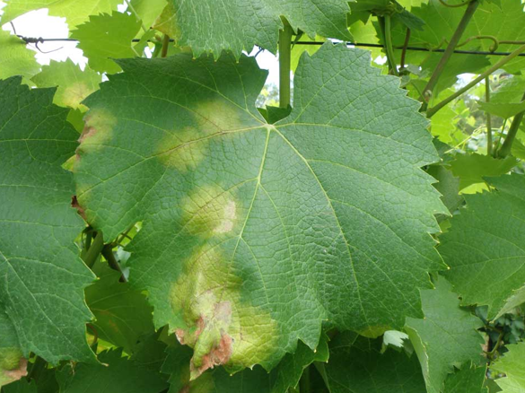
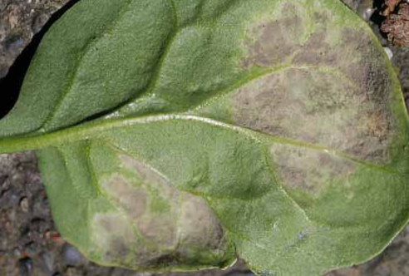
Plant Pathogenic Oomycetes
Peronosporaceae – downy mildews
Peronospora, Plasmopara, Pseudoperonospora, Bremia, Sclerospora
Notes:
(obligate parasite)
Peronospora on spinacia, plasmopara viticola on grape
(sporangiophores in bunches from stomata

Slide 17
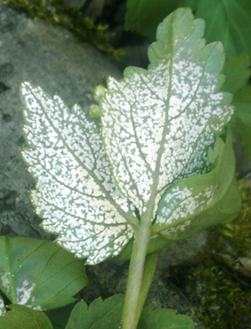
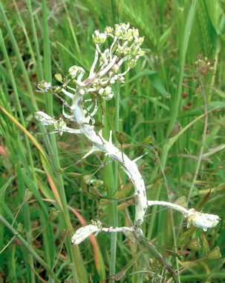
Plant Pathogenic Oomycetes
Albuginaceae – White rusts
Albugo spp.
Chains of sporangia rupture host epidermis

Slide 18
MICROSCOPE TUTORIAL
https://www.youtube.com/watch?v=WP9ebxtcLhQ
Notes:
https://www.youtube.com/watch?v=WP9ebxtcLhQ

Slide 19
In Lab Today
Look at plant specimens, note signs and symptoms
Make slides to observe Oomycota structures
Recognize sporangia, zoospores, and oospores and understand their function
Label a pear for Oomycota baiting experiment
Fill in the answers to the questions at the end of the lab
Begin to work on Disease of the Week #1

Slide 20
Disease of the Week
Look at the plant material – what is the crop?
Look at sample (dissecting scope)
Make slides (compound scope)
Reference books
Internet search
If necessary look at related host plants for more clues
Fill in disease of the week sheet
Due in 2 weeks (October 16th) at the beginning of lab
25 points

